Slide 1
COSC 0150:
DATABASE SYSTEMS 1

Slide 2
Definition of terms
Data: It is a collection of facts and figures that can be processed to produce information.
Information is the processed data on which decisions and actions are based. Information can be defined as the organized and classified data to provide meaningful values.
Database A database is an integrated collection of logically related records or files consolidated into a common pool that provides data for one or more multiple uses.
A database is designed, built, and populated with data for a specific purpose. It has an intended group of users and some preconceived applications in which these users are interested

Slide 3
Before the use of computer, a manual file system was used to maintain the records and files. All the data was stored in files. But this system was good only for small organizations having small number of items.
It has many disadvantages given below:
  It was time consuming.
  Inefficient to maintain the record of big firm having large number of items.
  It requires a lots of labor work to do.
  It becomes more complex when anyone requires changing the information.
To overcome these disadvantages and to make the processing fast, File Processing System was introduced. This system was able to solve all the above problems but also had its disadvantages

Slide 4
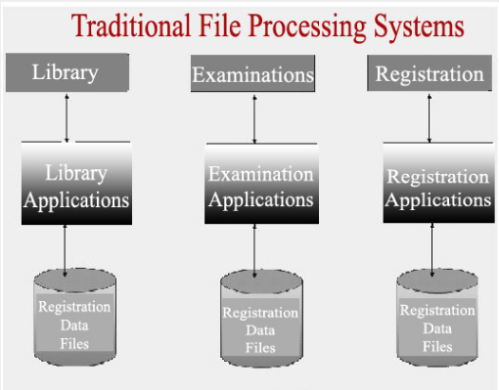
Traditional File Processing System
It was totally computer based system where all the information was stored in different computer files.
Additionally, traditional files system stores data in a manner that all the departments of an organization have their own set of files that creates data redundancy.
A typical Traditional File Processing Systems is shown in the diagram that shows program and data independency.

Slide 5
Characteristics OF Traditional File Processing System
It stores data of an organization in group of files.
Files carrying data are independent on each other.
COBOL, C, C++ programming languages were used to design the files.
Each file contains data for some specific area or department like library, student fees, and student examinations.
It is less flexible and has many limitations.
It is very difficult to maintain file processing system.
Any change in one file affects all the files that creates burden on the programmer.

Slide 6
Overall, Traditional File Processing Systems was good in many cases in comparison to manual non computer based system but still it had many disadvantages that were overcome by Data Base Management System.

Slide 7
Database Management System (DBMS)
A database management system (DBMS) is a collection of programs that enables users to create and maintain a database.
The DBMS is hence a general-purpose software system that facilitates the processes of defining, constructing, manipulating, and sharing databases among various users and applications.
  Defining a database involves specifying the data types, structures, and constraints for the data to be stored in the database.
  Constructing the database is the process of storing the data itself on some storage medium that is controlled by the DBMS.

Slide 8
Database Management System (DBMS)
Manipulating a database includes such functions as querying the database to retrieve specific data, updating the database to reflect changes in the miniworld, and generating reports from the data.
Sharing a database allows multiple users and programs to access the database concurrently.

Slide 9
Database Management System (DBMS)
Other important functions provided by the DBMS include
Protecting the database: Protection includes both system protection against hardware or software malfunction (or crashes), and security protection against unauthorized or malicious access
Maintaining it over a long period of time: A typical large database may have a life cycle of many years, so the DBMS must be able to maintain the database system by allowing the system to evolve as requirements change over time.

Slide 10
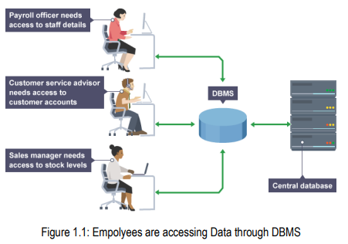
Database Management System (DBMS)
A database in a DBMS could be viewed by lots of different people with different responsibilities. For example

Slide 11
CHARACTERISTICS OF THE DATABASE APROACH
In the database approach, a single repository of data is maintained that is defined once and then is accessed by various users.
The main characteristics of the database approach versus the file-processing approach are the following:
  Self-describing nature of a database system
  Insulation between programs and data, and data abstraction
  Support of multiple views of the data
  Sharing of data and multiuser transaction processing

Slide 12
  1. Self-describing nature of a database system
Fundamental characteristic of the database approach is that the database system contains not only the database itself but also a complete definition or description of the database structure and constraints.
This definition is stored in the DBMS catalog, which contains information such as the structure of each file, the type and storage format of each data item, and various constraints on the data.
The information stored in the catalog is called meta-data, and it describes the structure of the primary database

Slide 13
  2. Insulation between programs and data, and data abstraction
In traditional file processing, the structure of data files is embedded in the application programs, so any changes to the structure of a file may require changing all programs that access this file.
By contrast, DBMS access programs do not require such changes in most cases.
The structure of data files is stored in the DBMS catalog separately from the access programs. We call this property program-data independence.

Slide 14
  2. Insulation between programs and data, and data abstraction
For example, a file access program may be written in such a way that it can access only STUDENT records of the structure.
If we want to add another piece of data to each STUDENT record, say the BirthDate, such a program will no longer work and must be changed.
By contrast, in a DBMS environment, we just need to change the description of STUDENT records in the catalog to reflect the inclusion of the new data item BirthDate; no programs are changed.
The next time a DBMS program refers to the catalog, the new structure of STUDENT records will be accessed and used.

Slide 15
  3. Support of multiple views of the data
A database typically has many users, each of whom may require a different perspective or view of the database.
A view may be a subset of the database or it may contain virtual data that is derived from the database files but is not explicitly stored.
Some users may not need to be aware of whether the data they refer to is stored or derived.
A multiuser DBMS whose users have a variety of distinct applications must provide facilities for defining multiple views.

Slide 16
  4. Sharing of data and multiuser transaction processing
A multiuser DBMS, as its name implies, must allow multiple users to access the database at the same time.
This is essential if data for multiple applications is to be integrated and maintained in a single database.
The DBMS must include concurrency control software to ensure that several users trying to update the same data do so in a controlled manner so that the result of the updates is correct.

Slide 17
ADVANTAGES OF USING THE DBMS APROACH
1. Controlling of Redundancy: Data redundancy refers to the duplication of data (i.e storing same data multiple times). In a database system, by having a centralized database and centralized control of data by the DBA the unnecessary duplication of data is avoided. It also eliminates the extra time for processing the large volume of data. It results in saving the storage space.
2. Security : Having complete authority over the operational data, enables the DBA in ensuring that the only mean of access to the database is through proper channels. The DBA can define authorization checks to be carried out whenever access to sensitive data is attempted.

Slide 18
ADVANTAGES OF USING THE DBMS APROACH
3. Data Consistency : By eliminating data redundancy, we greatly reduce the opportunities for inconsistency. For example: is a registration number is stored only once, we cannot have disagreement on the stored values. Also updating data values is greatly simplified when each value is stored in one place only. Finally, we avoid the wasted storage that results from redundant data storage.
4. Enforcing Integrity constraints
Integrity means that the data in the database is accurate. Most database applications have certain integrity constraints that must hold for the data. A DBMS should provide capabilities for defining and enforcing these constraints. The simplest type of integrity constraint involves specifying a data type for each data item

Slide 19
ADVANTAGES OF USING THE DBMS APROACH
5. Providing Storage Structures for Efficient Query Processing
Database systems must provide capabilities for efficiently executing queries and updates.
Because the database is typically stored on disk, the DBMS must provide specialized data structures to speed up disk search for the desired records.
Auxiliary files called indexes are used for this purpose. Indexes are typically based on tree data structures or hash data structures, suitably modified for disk search.
In order to process the database records needed by a particular query, those records must be copied from disk to memory.

Slide 20
ADVANTAGES OF USING THE DBMS APROACH
6. Providing Backup and Recovery
A DBMS must provide facilities for recovering from hardware or software failures.
The backup and recovery subsystem of the DBMS is responsible for recovery. For example, if the computer system fails in the middle of a complex update transaction, the recovery subsystem is responsible for making sure that the database is restored to the state it was in before the transaction started executing.
Alternatively, the recovery subsystem could ensure that the transaction is resumed from the point at which it was interrupted so that its full effect is recorded in the database.

Slide 21
DBMS Overheads
In spite of the advantages of using a DBMS, there are a few situations in which such a system may involve unnecessary overhead costs that would not be incurred in traditional file processing.
The overhead costs of using a DBMS are due to the following:
  High initial investment in hardware, software, and training
  The generality that a DBMS provides for defining and processing data
  Overhead for providing security, concurrency control, recovery, and integrity functions

Slide 22
Database users
Many people are involved in the design, use, and maintenance of a large database with hundreds of users.
A typical DBMS has users with different rights and permissions who use it for different purposes.
The users of a DBMS can be broadly categorized as follows

Slide 23
Database users
Database Administrators (DBA)
In any organization where many persons use the same resources, there is a need for a chief administrator to oversee and manage these resources.
In a database environment, the primary resource is the database itself, and the secondary resource is the DBMS and related software.
Administering these resources is the responsibility of the database administrator (DBA).

Slide 24
Database users
Database Administrators (DBA)
The DBA is responsible for
Authorizing access to the database.
Coordinating and monitoring its use
Acquiring software and hardware resources as needed.
The DBA is also accountable for problems such as breach of security or poor system response time.

Slide 25
Database users
2. Database Designers
Database designers are responsible for identifying the data to be stored in the database and for choosing appropriate structures to represent and store this data.
These tasks are mostly undertaken before the database is actually implemented and populated with data.
It is the responsibility of database designers to communicate with all prospective database users in order to understand their requirements, and to come up with a design that meets these requirements.

Slide 26
Database users
3. End users
End users are the people whose jobs require access to the database for querying, updating, and generating reports; the database primarily exists for their use

Slide 27
Components of a database system
Database systems constitute five elements/components:
1. Hardware
Hardware refers to the physical, electronic devices such as computers and hard disks that offer the interface between computers and real-world systems.
2. Software
Software is a set of programs used to manage and control the database and includes the database software, operating system, network software used to share the data with other users, and the applications used to access the data.

Slide 28
Components of a database system
3. Data
Data are raw facts and information that need to be organized and processed to make it more meaningful. Database dictionaries are used to centralize, document, control, and coordinate the use of data within an organization. A database is a repository of information about a database (also called metadata).

Slide 29
Components of a database system
4. Procedures
Procedures refer to the instructions used in a database management system and encompass everything from instructions to setup and install, login and logout, manage the day-to-day operations, take backups of data, and generate reports.
5. Database Access Language
Database Access Language is a language used to write commands to access, update, and delete data stored in a database. Users can write commands using Database Access Language before submitting them to the database for execution. Through utilizing the language, users can create new databases, tables, insert data, and delete data.

Slide 30
Database System Concepts and Architecture
The architecture of DBMS packages has evolved from the early monolithic systems, where the whole DBMS software package was one tightly integrated system, to the modern DBMS packages that are modular in design, with a client/server system architecture.
This evolution mirrors the trends in computing, where large centralized mainframe computers are being replaced by hundreds of distributed workstations and personal computers connected via communications networks to various types of server machines-s-Web servers, database servers, file servers, application servers, and so on.

Slide 31
Database System Concepts and Architecture
Database server is based on a Client-Server Architecture and is intended for end-users known as clients who send requests to the Server installed on a particular computer.
The client can be any computer that requests something from the serve on the other hand, the Server is the computer that is designed to serve the requests to the client.
Client-server architecture is a computing model in which the server hosts, delivers and manages most of the resources and services to be consumed by the client. This type of architecture has one or more client computers connected to a central server over a network or internet connection.

Slide 32
Database System Concepts and Architecture
There are THREE DBMS architectures namely
  Single tier architecture
  Two-tier architecture
  Three-tier architecture

Slide 33
Client - server Architecture types
There are THREE DBMS architectures based on the client server model namely
  Single tier architecture
  Two-tier architecture
  Three-tier architecture

Slide 34
1. Single tier architecture
This is a monolithic system architecture where the database is readily available on the client machine and therefore any request made by client doesn’t require a network connection to perform the action on the database.

Slide 35
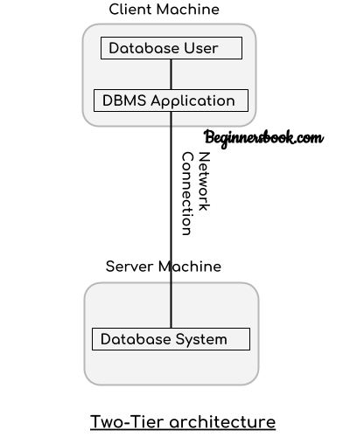
2. Two tier architecture
In two-tier architecture, the Database system is present at the server machine and the DBMS application is present at the client machine, these two machines are connected with each other through a reliable network as shown in the above diagram.
Whenever client machine makes a request to access the database present at server using a query language like SQL, the server perform the request on the database and returns the result back to the client. The application connection interface such as JDBC, ODBC are used for the interaction between server and client.

Slide 36
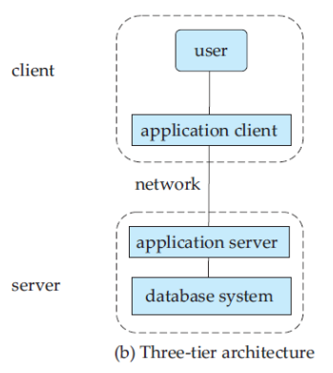
3. Three tier architecture
in a three-tier architecture, the client machine acts as merely a front end and does not contain any direct database calls. Instead, the client end communicates with an application server, usually through an interface.
The application server in turn communicates with a database system to access data. The business logic of the application, which says what actions to carry out under what conditions, is embedded in the application server, instead of being distributed across multiple clients. Three-tier applications are more appropriate for large applications, and for applications that run on the WorldWideWeb.

